Slide 1
MVC – Model View Controller
Waqar Yar

Slide 2
Head First Servlets & JSP
“Head First Servlets & JSP”- This is a book with excellent material to learn web programming
Code samples are also given there.
Step by step instructions are also given to run web applications.

Slide 3
View
This is the HTML page the user sees in the web browser
The view usually collects from data and sends it off to the server in the form of POST or GET request.

Slide 4
Architecture
Server
Container
Client
servlet
DB
View files (HTML,JSP, ASP)
POJO

Slide 5
Process Flow
The Client makes a request for the form.html page.
The Container retrieves the form.html page.
The Container returns the page to the browser, where the user answers the question.
The browser send the request data to the container.
The Container find the correct servlet based on the URL, and passes the request to the servlet.

Slide 6
Process Flow-2
The servlet calls the CoffeeExpert.
The expert class returns and answer, which the servlet adds to the request object.
The servlet forwards the request to the JSP.
The JSP gets the answer from the request object.

Slide 7
Process Flow 3
The JSP generates a page for the Container.
The Container returns the page to the user.

Slide 8
Development Environment
MyProject
CoffeeV1
etc
lib
src
classes
web
Web.xml
com
com
Result.jsp
Form.html
example
example
web
model
web
model
CoffeeSelect.java
CoffeeExpert.java
CoffeeSelect.java
CoffeeExpert..class

Slide 9
Deployment Environment
Tomcat
webapps
CoffeeV1
WEB-INF
form.hml
resut.jsp
classes
lib
Web.xml
com
example
web
model
CoffeeSelect.java
CoffeeExpert..class

Slide 10
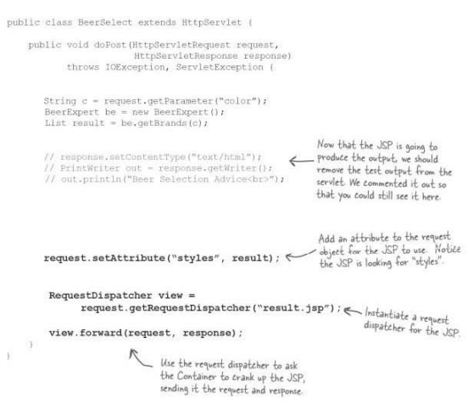
Servlet Dispatches to JSP

